Slide 1
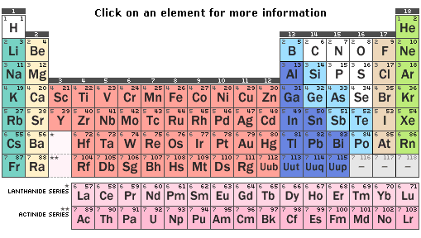
LANTHANIDES

Slide 2
Lanthanides ,also called rare earth elements comprise of a group of 15 elements of which only one, promethium (Pm) does not occur naturally in the earths crust while the other fourteen are relatively abundant in rocks and soils. "The series of fifteen metallic elements from lanthanum to lutetium are called lanthanides. In these elements the differentiating electron enters 4f-orbitals. The name lanthanides has been derived from lanthanum (La) element which is the prototype of lanthanides
Position in Periodic table – In 6th period after La the incoming electron enters the 4f orbital and the following 14 elements are called Lanthanide/Lanthanones. Placed outside the body of main periodic table as they resemble each other very closely and keeping them inside the main table will over rule periodic law.
Electronic configuration - The general electronic configuration of these elements is ns² (n-1)d⁰⁻¹ (n-2)f¹⁻¹⁴. They resemble each other very closely as they have same electronic configuration in nth and (n-1) valency shell. Their most common oxidation state is +3 involving only 5d¹ and 6s² electrons.
An alternate electronic configuration is also suggested that after Ce, the d electron also shifts to 4f orbital, except for those elements where it will disturb f¹ or f¹⁴ configuration.

Slide 3
1.Electronic configuration
Element name Symbol Ln Ln³⁺ Radius
I II Ln³⁺/ pm
Lanthanum 57 La [Xe] 4f⁰6s²5d¹ [Xe] 4f⁰6s²5d¹ [Xe]4f⁰ 116
Cerium 58 Ce [Xe] 4f¹6s²5d¹ [Xe]4f¹6s²5d¹ [Xe]4f¹ 114
Praseodymium 59Pr [Xe] 4f²6s²5d¹ [Xe]4f³6s² [Xe]4f² 113
Neodymium 60 Nd [Xe] 4f³6s²5d¹ [Xe]4f⁴6s² [Xe]4f³ 111
Promethium 61 Pm [Xe] 4f⁴6s²5d¹ [Xe]4f⁵6s² [Xe]4f⁴ 109
Samarium 62 Sm [Xe] 4f⁵6s²5d¹ [Xe]4f⁶6s² [Xe]4f⁵ 108
Europium 63 Eu [Xe] 4f⁶6s²5d¹ [Xe]4f⁷6s² [Xe]4f⁶ 107
Gadolinium 64 Eu [Xe] 4f⁷6s²5d¹ [Xe]4f⁷6s²5d¹ [Xe]4f⁷ 105
Terbium 65 Tb [Xe] 4f⁸6s²5d¹ [Xe] 4f⁹6s² [Xe]4f⁸ 104
Dysprosium 66 Dy [Xe] 4f⁹6s²5d¹ [Xe] 4f¹⁰6s² [Xe]4f⁹ 103
Holmium 67 Ho [Xe] 4f¹⁰6s²5d¹ [Xe] 4f¹¹6s² [Xe]4f¹⁰ 102
Erbium 68 Er [Xe] 4f¹¹6s²5d¹ [Xe] 4f¹²6s² [Xe]4f¹¹ 100
Thulium 60 Tm [Xe] 4f¹²6s²5d¹ [Xe] 4f¹³6s² [Xe]4f¹² 99
Ytterbium 70 Yb [Xe] 4f¹³6s²5d¹ [Xe] 4f¹⁴6s² [Xe]4f¹³ 99
Lutetium 71 Lu [Xe] 4f¹⁴6s²5d¹ [Xe] 4f¹⁴6s²5d¹ [Xe]4f¹⁴ 98

Slide 4
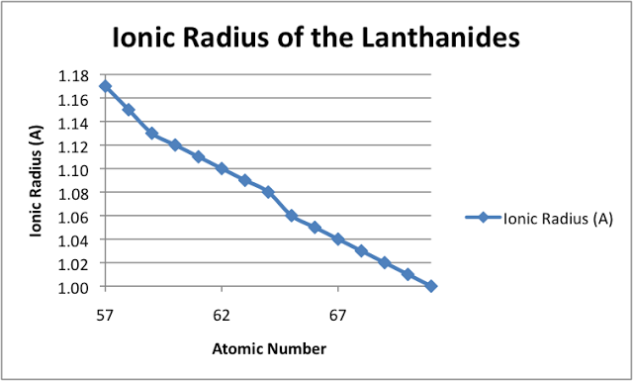
2. Lanthanide Contraction
Definition - The steady decrease in the size of the atoms and ions of the rare-earth elements with increasing atomic number from lanthanum (atomic number 57) through lutetium (atomic number 71) is known as the lanthanide contraction. For each consecutive atom the nuclear charge increases by one unit, accompanied by a corresponding increase in the number of electrons present in the 4f orbitals.
Cause – The new electrons enter the 4f orbital which have very poor shielding effect
due to their diffused shape, as a result nuclear attraction increases and electron shells contract.
Consequences –
Among the lanthanides
Post Lanthanides

Slide 5
Consequences –
I Among Lanthanides –
1. Basicity of ions- decreases from La ³⁺ to Lu³⁺ so their oxides and hydroxides are less basic
2. As the atomic size decreases across the series the elements following lanthanides show change in their physical properties.
a) The ionisation potential increases
b) Metallic nature decreases
c) Electropositivity decreases
d) Electronegativity Increseases
e) Tendency to form complexes increases
II Post Lanthanides –
i) Occurrence of elements as pairs – Due to similar size of 4d and 5d in a group, they have similar physical and chemical properties, they occur together in nature and their separation becomes very difficult.
Zr/Hf, Nb/Ta, Mo/W
ii)Densities – 5d elements have very high densities as down the group there is large increase in mass but no increase in volume.
III Occurrence of Yttrium along with heavier lanthanides –
yttrium has similar charge and size to Ho³⁺ & Er³+ hence it occurs with and separation is difficult.

Slide 6
3. Oxidation States
Symbol | Idealized | Observed | M³⁺ | M²⁺ | M⁴⁺ | At. Radii A* | N0. of f- electron
La | [Xe] 4f⁰5d¹6s² | [Xe] 4f⁰5d¹6s² | [Xe] | - |  | 1.88 | 0
Ce | [Xe]4f¹5d¹6s² | [Xe]4f²5d⁰6s² | 4f1 | 4f² | [Xe] | 1.82 | 1
Pr | [Xe]4f²5d¹6s² | [Xe]4f³ 5d⁰6s² | 4f² | - | 4f¹ | 1.83 | 2
Nd | [Xe]4f³5d¹6s² | [Xe]4f⁴ 6s² | 4f³ | 4f⁴ | 4f² | 1.82 | 3
Pm | [Xe]4f⁴5d¹6s² | [Xe]4f⁵ 6s² | 4f⁴ | - | - |  | 4
Sm | [Xe]4f⁵5d¹6s² | [Xe]4f⁶ 6s² | 4f⁵ | 4f⁶ | - | 1.80 | 5
Eu | [Xe]4f⁶5d¹6s² | [Xe]4f⁷ 6s² | 4f⁶ | 4f⁷ | - | 2.04 | 6
Gd | [Xe]4f⁷5d¹6s² | [Xe]4f⁷5d¹6s² | 4f⁷ | - | - | 1.80 | 7
Tb | [Xe]4f⁸5d¹6s² | [Xe]4f⁹ 6s² | 4f⁸ | - | 4f⁷ | 1.78 | 8
Dy | [Xe]4f⁹5d¹6s² | [Xe]4f¹⁰ 6s² | 4f⁹ | - | 4f⁸ | 1.77 | 9
Ho | [Xe]4f¹⁰5d¹6s² | [Xe]4f¹¹ 6s² | 4f¹⁰ | - | - | 1.77 | 10
Er | [Xe]4f¹¹5d¹6s² | [Xe]4f¹² 6s² | 4f¹¹ | - | - | 1.76 | 11
Tm | [Xe]4f¹²5d¹6s² | [Xe]4f¹³ 6s² | 4f¹² | 4f¹³ | - | 1.75 | 12
Yb | [Xe]4f¹³5d¹6s² | [Xe]4f¹⁴ 6s² | 4f¹³ | 4f¹⁴ | - | 1.94 | 13
Lu | [Xe]4f¹⁴5d¹6s² | [Xe]4f¹⁴5d¹6s² | 4f¹⁴ | - | - | 1.73 | 14

Slide 7
Oxidation States
The configuration of La ³⁺ ion, is that of xenon which is highly stable. So, it is not possible to have a La+4 ion.
In the same way Ga, Lu also form only +3 ions, because the removal of three electrons give stable half filled 4f⁷ configuration for Gd ³⁺ ion and in completely filled 4f1-4 configuration for Lu ³⁺ ions.
In other Lanthanides, +2 and +4 oxidations states also occur but these are always less table than the +3 oxidation state which is characteristic of this family
The +2 and +4 oxidation states are shown by those elements which will attain f ⁰, f ⁷ and f ¹⁴ configurations by doing so
For eg . Ce ⁴⁺, Eu ²⁺ are 4f ⁷, Tb ⁴⁺ - 4f ⁷, Yb ²⁺ – 4f ¹⁴
extra stability is associated with f ⁰, f ⁷, f ¹⁴ configurations.

Slide 8
4. Magnetic Behaviour
La+3 and Lu+3 do not contain any unpaired electrons, so they do not show paramagnetism. All other tri positive ions of lanthanides are paramagnetic.
the 4f electrons are deep inside the ion and are well shielded from the quenching effect of the environment. The 4f-orbitals are well shielded from the surroundings by the overlying 5s and 5p- orbitals . As a result, the electric field of the ligands surrounding the ion does not restrict the orbital motion of the electron. So, in this case the observed paramagnetism is due to both factors – the electron spin and orbital motion.
µ _{S+L} = √ 4S ( S+1) + L ( L+1)
S- spin contribution, L – Orbital contribution
The magnetic moments of tri positive lanthanide ions are plotted against their respective atomic number .The value increases up to Nd+3 and then drops to (1.47) sm+3. it raises again and becomes maximum Dy+3 and starts dropping to zero for Lu+3 (f14) which is diamagnetic.

Slide 9
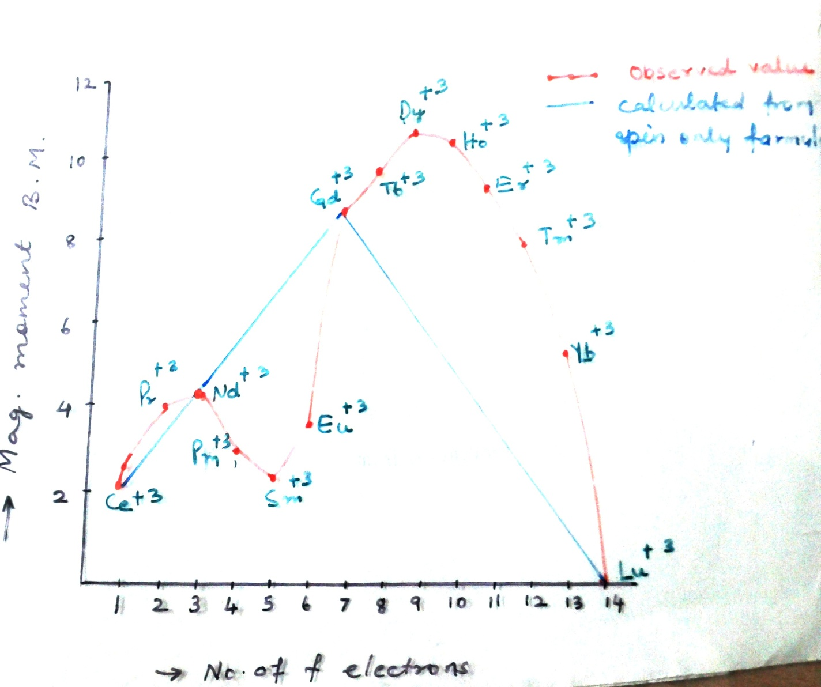

Slide 10
5. Colour - The colour of the Ln ³⁺cations to a large extent depend upon the electronic configuration. For eg. La ³⁺(4f ⁰), Gd ³⁺(4f ⁷) and Lu ³⁺ (4f ¹⁴) are colourless. The colour is due to f—f transitions i.e. transition of the electrons from the lower energy f-orbitals to the higher energy f orbital. The colour of ion having n no. of f- electron is same as that of element having (14 – n) no.
6. Complexes -Lanthanides are moderate in their complex forming ability which increases to the right . Although tripositive cations have a high charge equal to +3 on them, their size is so large, their charge to radius ratio becomes so small that these ions have less tendency to form complexes, eg: Stable complexes are known with chelating oxygen containing ligands like EDTA, oxalic acid, acetylacetone, . There is a general decrease in complex formation with a specific ligands from Ln ⁴⁺> Ln ³⁺>Ln ²⁺ as charge decreases

Slide 11
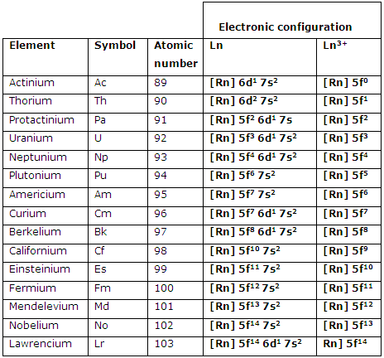
Actinides

Slide 12
Electronic Configuration
Element | Seaborg view | Dawson View | Oxidation States
Ac | [Rd] 5f⁰ 6d¹ 7s² | [Rd] 5f⁰ 6d¹ 7s² | +3, +2
Th | [Rd] 5f¹ 6d¹ 7s² | [Rd] 5f⁰ 6d² 7s² | +4
Pa | [Rd] 5f² 6d¹ 7s² | [Rd] 5f⁰ 6d³ 7s² | +4, +5
U | [Rd] 5f³ 6d¹ 7s² | [Rd] 5f⁰ 6d⁴ 7s² | +4, +5, +6
Np | [Rd] 5f⁴ 6d¹ 7s² | [Rd] 5f⁴ 6d¹ 7s² | +4, +5, +6, +7
Pu | [Rd] 5f⁵ 6d¹ 7s² | [Rd] 5f⁵ 6d¹ 7s² | +4 , +5 , +6
Am | [Rd] 5f⁶ 6d¹ 7s² | [Rd] 5f⁶ 6d¹ 7s² | +3, +4, +5, +6
Cm | [Rd] 5f⁷ 6d¹ 7s² | [Rd] 5f⁷ 6d¹ 7s² | +3
Bk | [Rd] 5f⁸ 6d¹ 7s² | [Rd] 5f⁸ 6d¹ 7s² | +3
Cf | [Rd] 5f⁹ 6d¹ 7s² | [Rd] 5f⁹ 6d¹ 7s² | +3
Es | [Rd] 5f¹⁰ 6d¹ 7s² | [Rd] 5f¹⁰ 6d¹ 7s² | +3
Fm | [Rd] 5f¹¹ 6d¹ 7s² | [Rd] 5f¹¹ 6d¹ 7s² | +3
Md | [Rd] 5f¹² 6d¹ 7s² | [Rd] 5f¹² 6d¹ 7s² | +3
No | [Rd] 5f¹³ 6d¹ 7s² | [Rd] 5f¹³ 6d¹ 7s² | +2 (f¹⁴ )
Lr | [Rd] 5f¹⁴ 6d¹ 7s² | [Rd] 5f¹⁴ 6d¹ 7s² | +3

Slide 13
1.Atomic Radii –
Steady decrease from Ac to Lr due to imperfect shielding by f- orbitals due to their diffused shape is known as Actinide contraction.
2. Oxidation States –
  +3 is most common stable O.S.
  Higher oxidation states are more common for elements upto Np.
  O. S. upto +6 are stable.
3. Colour :
Metals, ions are coloured due to f-f transitions and intense change transfer transitions.
fº, f⁷, f¹⁴ –ions are colour less.

Slide 14
4. Complex formations:
Far greater tendency than Lanthanides due to high charge and small size.
  M⁴⁺ shows greatest tendency
  M⁴⁺ >MO₂ ²⁺ M³⁺ >MO₂⁺
  High coordn. Nos., upto 8, 9 are common
  Adducts are formed with alkali metal halides.
  ThCl₄ + MCl → MThCl₅, M₂ ThCl₂ etc
  (v) Many complexes are formed with chelating agents viz oxine, EDTA, acetyl acetone
  (vi) Complexes are formed with ⁁ - ligands also viz Thioether, phosphine
  (vii) Stability with singly charged ions follows the trend
  F⁻ >NO₃⁻ >Cl⁻ and
  Doubly charged ions – CO₃²⁻ >C2O4 ²⁻ >SO₄²⁻

Slide 15
Separation of Lanthanides
Solvent extraction method
This method is based on the difference in partition co-effecients of lanthanide salts between water and organic solvents. The solvents employed in this method of extraction of the lanthanides are usually tri n-butyl phosphate (TBP) and di (2-ethylhexy) phosphoric acid. For eg. Gd(NO3)3 can be separated from La (NO₃) ₃ by continuous extraction with water from a solution of these salts in TBP .

Slide 16
(ii) Ion exchange method:
A synthetic ion-exchange resin with functional groups like – COOH and –SO ₃H is packed in a long column fixed in a vertical position.
The steady decrease in size and consequent decrease in basicity causes the steady increase the complexing ability with increasing atomic number of lanthanides. When an aqueous solution containing `the mixture of trivalent lanthanide ion M+3(aq) is passed through a column having synthetic cation-exchange resin (HR)solid, the M+3 ions replace H+ ion of the resin and thus get fixed on that
M+3 (aq) + 3 HR → MR3 (solid) + 3H+(aq)

Slide 17
Small Lu ³⁺ gets more hydrated than La ³⁺ and is bigger in size. So La(aq) ³⁺ gets strongly bound to the resin column than others.
In order to recover M3+ ions fixed on the resin, the column is eluted with a citric acid – ammonium citrate solution (eluant). During elution process NH4+ ions replace M+3 ion and M- citrate complexes are formed.
The bigger aquated ion is least strongly held and comes out first. Other ions remain on the column and can be separated by repeated elution.
R – M³⁺ + NH₄⁺ R - NH₄⁺ + M³⁺ - citrate

